Slide 1
APUSH Review: The Enlightenment
www.Apushreview.com
Everything You Need To Know About The Enlightenment To Succeed In APUSH

Slide 2
The New Curriculum And The Enlightenment
Key Concept 2.3, I, B: “Several factors promoted Anglicization in the British colonies: the growth of autonomous political communities based on English models, the development of commercial ties and legal structures, the emergence of trans-Atlantic print culture, Protestant evangelism, religious toleration, and the spread of European Enlightenment ideas .”
Page 30 of the Curriculum framework
The Enlightenment had tremendous impact on American (and world) politics and society
Since it is mentioned specifically, you should be very familiar with it

Slide 3
Background Info
What was it?
Movement that believed that reason and knowledge could lead to progress and advancements in society
When did it occur?
17th and 18th centuries, originating in Europe
Impact of the Enlightenment?
Helped challenge traditional authority

Slide 4
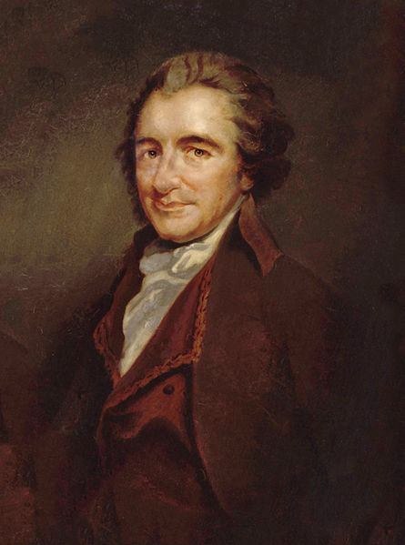
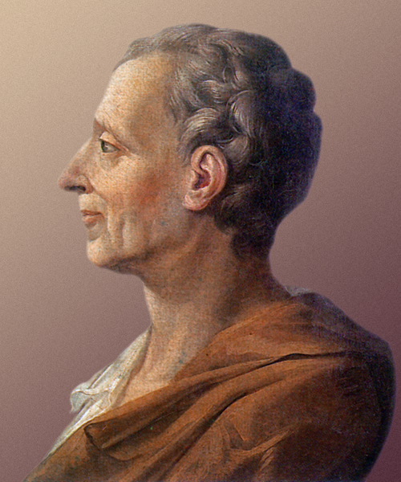
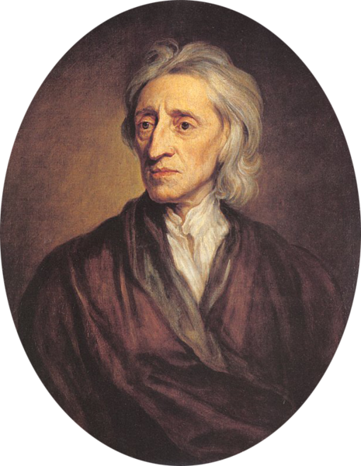
Key Enlightenment Thinkers
John Locke:
Two Treatises of Government
Natural rights – “life, liberty, and property.”
“Consent of the governed” – government rules with people’s (governed) permission; people can overthrow governments if necessary
Influenced the Declaration of Independence
Baron de Montesquieu:
The Spirit of Laws
Advocated checks and balances and separation of powers
Dividing power among branches would help prevent government abuse
Influenced our current government system established under the Constitution
Thomas Paine (T-Paine!):
Common Sense
Advocated the US to declare independence from England
Influenced the Declaration of Independence

Slide 5
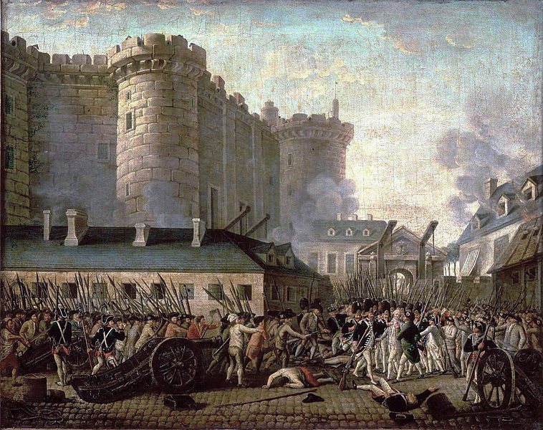
Impact of the Enlightenment
Key ideas are seen in US government
3 branches of government
Freedom of speech
The ideas which encouraged individuals to challenge authority and unjust government helped inspire the American Revolution
Enlightenment ideas were seen in other revolutions as well:
French Revolution
Latin American Revolutions

Slide 6
Test Tips
Multiple-Choice and Short Answer Questions:
Excerpt of a reading, what are impacts?
Short Answer – Identify and describe Enlightenment thinkers and their impacts
Essay Questions:
Causes of American Revolution – how did Enlightenment fit in?

Slide 7
Thanks for watching!
Subscribe to my channel
Help spread the word
Questions? Comments?
Leave in comments
It’s Common Sense to subscribe!
Subscribe
Down here!

